Slide 1
Fashion Retail
@Scale
to block or not to block
presented by
Jesús Manuel Piñeiro Cid

Slide 2
Java
Node.js
Not allways
an easy decision
O'REILLY Software Architecture Conference - Berlin 2019

Slide 3
Summary
About Us
Ecommerce platform
Transition challenges
Our Solution
Non-Blocking Vs. Blocking
Non-Blocking
Use Cases
Implementation Strategy
Experiences & Results
Future Use Cases
O'REILLY Software Architecture Conference - Berlin 2019

Slide 4
About
A brief history
Founded @ 1963
Biggest fashion distribution company worldwide
Traded @ Spain Stock Exchange (Ibex 35) since 2001.
Composed by 8 separate brands
We manage
Design
Fabricaton
Logistics & distribution
Sales
O'REILLY Software Architecture Conference - Berlin 2019

Slide 5
Ecommerce 2018
About
Brick & Mortar 2018
Main Numbers
7,500
+6%
1,254
520
Stores
Sales Increase
Items Sold / Min
Orders Taken / Min
180
+320%
15,254
2,547
O'REILLY Software Architecture Conference - Berlin 2019

Slide 6
Ecommerce Platform
Deployment Timeline
2007
2010
2011
2016
2017
2018
2019
Started digital transformation
Launch Integrated Sales Model
presence in
202 online markets
here
we are :D

Slide 7
O'REILLY Software Architecture Conference - Berlin 2019
ECOMMERCE FROM
MONOLITH
TO
MICROSERVICES

Slide 8
Transition Challenges
mantain a single
ecommerce solution
1
Avoid resources overhead
Single eccomerce product not eight
Single solution doesn't mean a single language
O'REILLY Software Architecture Conference - Berlin 2019

Slide 9
Transition Challenges
flexible & extensible
per brand
2
The product must be flexible & adaptable
Extensibility must be our creed
Object oriented language is a first pick
function oriented, but provide this capacities
O'REILLY Software Architecture Conference - Berlin 2019

Slide 10
Transition Challenges
avoid changes in the monolithic platform
3
All efforts will be thrown into the new platform
Make compromise solutions
temporary pieces, easier to develop
O'REILLY Software Architecture Conference - Berlin 2019

Slide 11
Transition Challenges
avoid re-coding
common functionalities
4
Authorization, observability, configuration, etc.
Development tooling
Homogeneous use
built a custom framework on top of it
O'REILLY Software Architecture Conference - Berlin 2019

Slide 12
Transition Challenges
responsiveness,
elasticity & resilency
5
Loosely coupled services
Design thinking in chaos not best scenario
Contenerized PaaS favor Horizontal scaling
Lean, less footprint & faster boot time
Doesn't handle well CPU Intensive tasks
O'REILLY Software Architecture Conference - Berlin 2019

Slide 13
Transition Challenges
Industrialize development
6
Enforce Typed languages
Frameworks can streamline & make development faster
Increase redability among teams
Facilitate sharing resources
O'REILLY Software Architecture Conference - Berlin 2019

Slide 14
Transition Challenges
Heterogeneous
technology stack
7
Support several customized frameworks is hard
Minimize technologies without loosing flexibility
I/O Intensive CPU Intensive
O'REILLY Software Architecture Conference - Berlin 2019

Slide 15
use the best fitted tool
to empower the business
O'REILLY Software Architecture Conference - Berlin 2019

Slide 16
O'REILLY Software Architecture Conference - Berlin 2019
ECOMMERCE
SOLUTION

Slide 17
Ecommerce Solution
Our proposal
Homologate
services among all brands
Independant development teams between services
On-Premise
PaaS
infrastructure
Standarized DevOps pipelines with CI/CD
Divide
into services
using DDD
Layered microservice architecture
In-house mantained framework
Pull-request
colaborative culture
ECOMMERCE
SOLUTION
O'REILLY Software Architecture Conference - Berlin 2019

Slide 18
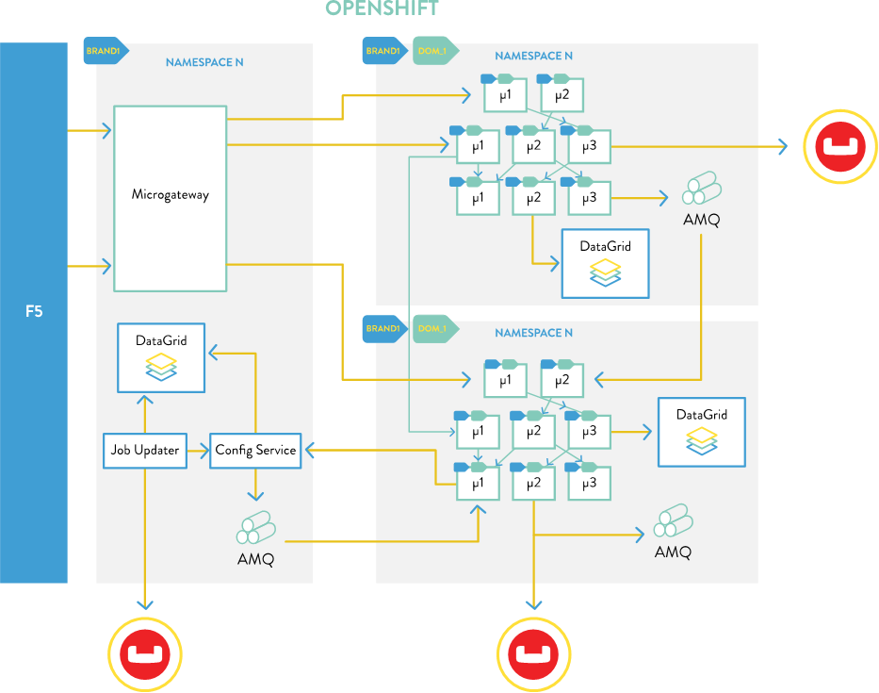
PaaS Architecture
Domain driven division
Brands isolated per namespace
Transversal domain - core
Microgateway
Configuration Service
3 layer architecture:
adapter
composite
core
Middlewares deployed inside each namespace
O'REILLY Software Architecture Conference - Berlin 2019

Slide 19
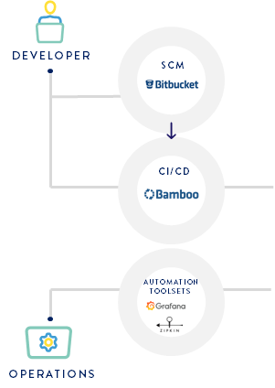
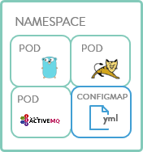
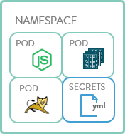
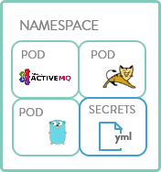
PaaS Structure
F5
routing layer
scm
master
node
node
node
API
Authentication
persistant
storage
ci/cd
Datastore
Scheduler
monitoring
Management /
Replication
services layer
physical
virtual
private
public
O'REILLY Software Architecture Conference - Berlin 2019

Slide 20
O'REILLY Software Architecture Conference - Berlin 2019
BLOCKING
VS.
NON-BLOCKING

Slide 21
Blocking
Non-Blocking
vs.
1m47s
Each request blocks a thread
until it's completed
1m15s
Single thread shared that
doesn't block
30s
1m
1m30s
2m
30s
1m
1m30s
2m
fixable adding a thread pool,
implies more resources
great for faster I/O,
sucks @ heavy computational tasks
O'REILLY Software Architecture Conference - Berlin 2019

Slide 22
Blocking
Non-Blocking
Normally multi threaded
Asyncronous operation is executed
the execution thread is blocked
Bigger cpu / memory footprint
Ideal for heavy computation
Easier to read, debug
Single main thread
Asyncronous operation is executed
the main thread is not blocked
Smaller cpu / memory footprint
Ideal for fast I/O
callback, promises & async / await
vs.
Compiled
Object-oriented
Strongely typed
Scripted
Function-oriented
Not stronglely-typed
O'REILLY Software Architecture Conference - Berlin 2019

Slide 23
Also provides...
High modularity
Huge package ecosystem
JSON Objects handling & manipulation by default
Commonly faster development & build times
Lightweight ideal for microservices environments
So... why force Java to solve problems
where Node.js excels and viceversa?
O'REILLY Software Architecture Conference - Berlin 2019

Slide 24
O'REILLY Software Architecture Conference - Berlin 2019
NON-BLOCKING
USE CASES

Slide 25
Our Non-Bocking use cases
1
API for object-oriented adaptations
Ussage limited mainly to our adapter layer
Perform request calls to composer / core layers (i.e. intelligent proxy)
Commonly does simple JSON adaptations
Reduced codebase length vs. Java counterpart (aprox 50% less lines)
Easy to develop & mantain
Fast throughtput and low latency
Highly scalable
O'REILLY Software Architecture Conference - Berlin 2019

Slide 26
Our Non-Bocking use cases
2
Microservices proxy
Use as an api-gateway to our PaaS verticals
Groups common functionality (i.e. authentication, rate-limiting, etc)
Simple request pipeline on top of express.js
Allows a more custom integration in our migration
Easy to develop & mantain
Fast throughtput and low latency
Highly scalable
O'REILLY Software Architecture Conference - Berlin 2019

Slide 27
Our Non-Bocking use cases
3
Web UI development
Great performance for UI
Executes on the browser, so distributes computational load
Promote SPA intranet / extranet
Promote SPA + Server Side Rendering internet
Fast & easy to work with
Fluid responsive UI's
Defacto use case for non-blocking
O'REILLY Software Architecture Conference - Berlin 2019

Slide 28
O'REILLY Software Architecture Conference - Berlin 2019
NON-BLOCKING
STRATEGY

Slide 29
Implementing Non-Blocking
Implementation Strategy
Build a
Node.js
Services
Framework
Build a
JavaScript
Web UI
Framework
Build a
Node.js
API
Gateway
Streamline DevOps operations
for Node.js & JavaScript
O'REILLY Software Architecture Conference - Berlin 2019

Slide 30
Implementing Non-Blocking
Implementation Strategy / Phases
Initialy only to be used on the adapter layer
TypeScript can be used but it's optional
Based on Koa framework
Implements common functionalities
Favor usage of async / await
Provides observability, trazability & debugging
Build a
Node.js
Services
Framework
O'REILLY Software Architecture Conference - Berlin 2019

Slide 31
Implementing Non-Blocking
Implementation Strategy / Phases
SPA (without SSR)
Used only on intranet / extranet
TypeScript can be used but it's optional
Based on React + Redux
Implements common functionalities
Reusable corporate components
Build a
JavaScript
Web UI
Framework
O'REILLY Software Architecture Conference - Berlin 2019

Slide 32
Implementing Non-Blocking
Implementation Strategy / Phases
Act as an single entry point
Fast & scalable for I/O
Auto-generates an API catalog
Concentrate common functional needs:
Authentication
Rate-limiting
Customs timeouts per route
Build a
Node.js
API
Gateway
O'REILLY Software Architecture Conference - Berlin 2019

Slide 33
Implementing Non-Blocking
Implementation Strategy / Phases
Node.js version lifecycle handling
Simple & customizable pipeline structure, throught package.json scripts
Private NPM packages repo
CI / CD
Streamline DevOps operations
for Node.js
O'REILLY Software Architecture Conference - Berlin 2019

Slide 34
O'REILLY Software Architecture Conference - Berlin 2019
IMPLEMENTATION
RESULTS

Slide 35
Non-Blocking Implementation
Experiences & Results
Increased performance, reliability & scalability on migrated use cases
Decreased resource footprint
Developments are more streamlined & fast
due to Framework + nature of Node.js
Favored ussage of async / await
simplyfies readiness and transition of Java oriented teams
O'REILLY Software Architecture Conference - Berlin 2019

Slide 36
Non-Blocking Implementation
Experiences & Results
Totaly independant & autonomous teams
Encourage the ussage of the right technology to solve an use case
The framework favored consistency & reusability between independant teams
Standarization facilitates the collaborative culture
O'REILLY Software Architecture Conference - Berlin 2019

Slide 37
Non-Blocking Implementation
Experiences & Results
Increased costs
Mantaining two service development frameworks
"The framework must handle it"
When it's functional domain related
Teams confortable with one technology tends to over-use-it
Trying to solve use cases that are not best fitted for the non-blocking approach
O'REILLY Software Architecture Conference - Berlin 2019

Slide 38
O'REILLY Software Architecture Conference - Berlin 2019
FUTURE
USE CASES

Slide 39
Future Use Cases
API on top of a NoSQL Object-oriented DB
Support database persistance (i.e. MongoDB)
Chat communication systems
Support real-time communication via websockets
Data streaming processing
Streams are a native part of Node.js
Java embraces non-blocking
Libraries like Reactor on top of Spring
O'REILLY Software Architecture Conference - Berlin 2019

Slide 40
thanks
reach me for questions / comments:
jesusmpc@inditex.com
join us @ Arteixo, Spain
https://techteams.es
#ZARATECHTEAMS
O'REILLY Software Architecture Conference - Berlin 2019

